Slide 1
Adopting cloud technologies
Notes:
This presentation provides some introductory discussion about adopting cloud technologies.

Slide 2
Agenda
Explain the timeline that led up to enterprises adopting cloud technologies
Discuss why enterprises adopt cloud technologies
Describe the following basic cloud concepts:
Characteristics
Deployment models
Service models
Describe the technologies necessary for the adoption of the cloud
Discuss cloud computing provisioning

Slide 3
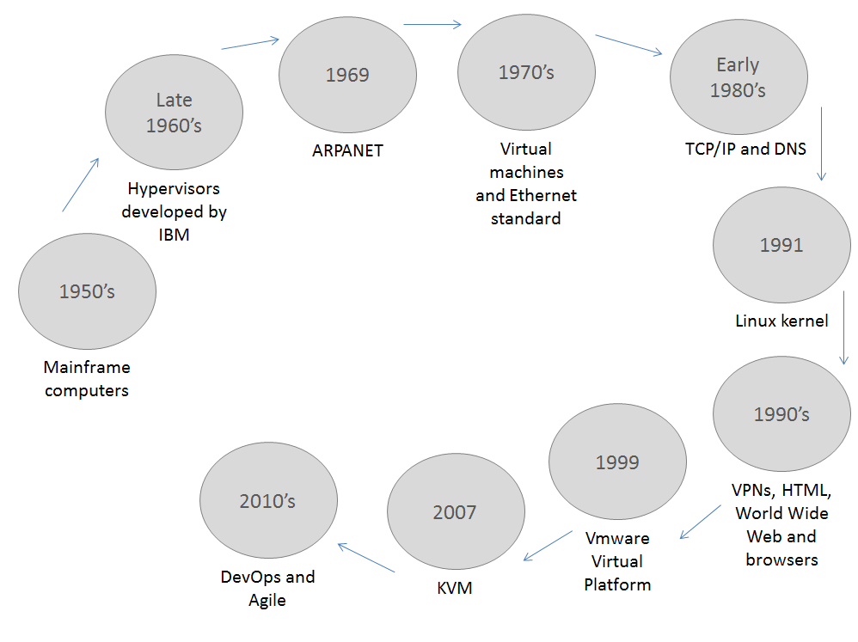
A timeline
Notes:
It is really difficult to write a history of cloud computing. Everyone has an opinion about where cloud computing started and which significant events/inventions/products are on the timeline. This graphic is an attempt to document some significant events. These can be considered snippets in time, so your interpretation of the cloud computing timeline may vary.
1950's “Time-sharing” on mainframes was essential to computer access by making computing time available to smaller companies that could not afford to buy their own mainframes.
Late 1960's The first hypervisors were developed at IBM which provided full virtualization by allowing multiple operating systems to run concurrently as virtual machines.
1969 J.C.R. Licklider and team develop ARPANET which envisioned computation in the form of a global network.
1970's Ethernet developed at Xerox PARC.
Early 1980's The TCP/IP suite becomes protocol for ARPANET and DNS establishes naming designations for websites.
1991 Linux kernel was conceived and created by Linus Torvalds for his personal computer with no cross-platform intentions.
1990's HTML developed by Tim Berners-Lee. CERN introduces the World Wide Web. Netscape creates the first web browser.
1999 VMware introduces the Vmware Virtual Platform.
2007 Kernel-based virtual machine created and included in the Linux kernel.
2010's DevOps and Agile become the basis of many projects changing the way developers and administrators do their work.

Slide 4
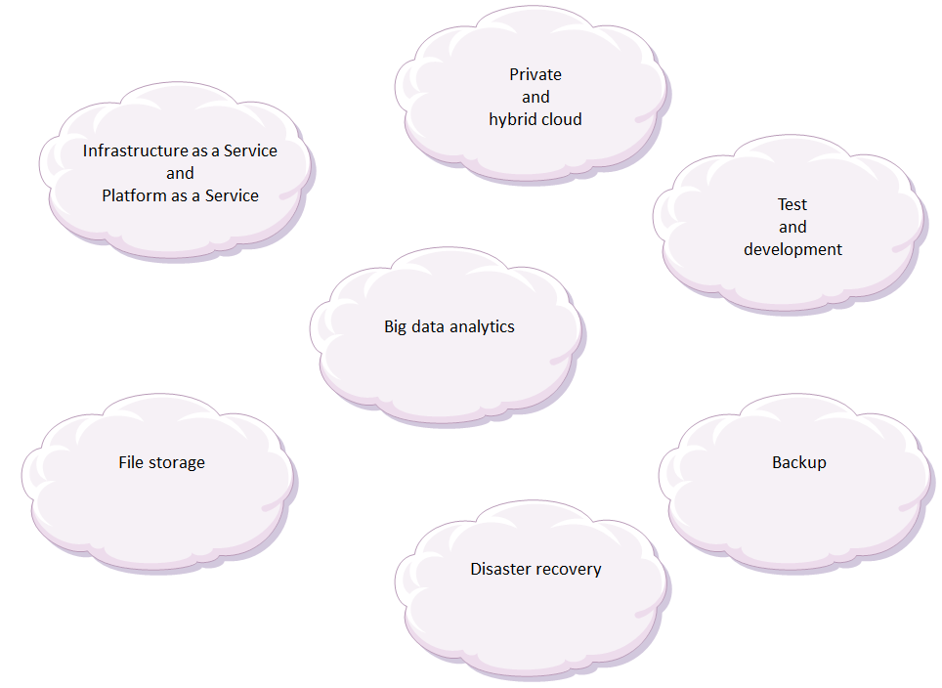
Why adopt cloud?
Notes:
There are many reasons why an enterprise might adopt cloud technologies. Cloud computing has been credited with increasing competitiveness through cost reduction, greater flexibility, elasticity and optimal resource utilization. This graphic and the accompanying explanation outlines where cloud computing has been used to achieve business goals.
While the list in the graphic is not exhaustive, it certainly gives an incentive to use the cloud when compared to more traditional alternatives to increase IT infrastructure flexibility, as well as leverage on big data analytics and mobile computing.
Infrastructure as a service (IaaS) and platform as a service (PaaS)
Using IaaS on a pay-per-use scheme is a logical choice for companies saving on the cost of investing to acquire, manage and maintain an IT infrastructure. There are also instances where organizations turn to PaaS for the same reasons while also seeking to increase the speed of development on a ready-to-use platform to deploy applications.
Private cloud and hybrid cloud
There are two situations where organizations exploring ways to assess applications they intend to deploy into their environment through the use of a cloud (specifically a private cloud). In the case of test and development environments, adopting a hybrid cloud allows for application workload testing. Another use of hybrid cloud is the ability to expand during periods of peak usage, which is often preferable to hosting a large infrastructure that might seldom be of use. An organization may want additional capacity and availability of an environment when needed.
Test and development
One strong case for using a cloud is standing up a test and development environment. This entails securing a budget, setting up the environment through physical assets, significant manpower and time. Next is the installation and configuration of the platform. These steps can often extend the time it takes for a project to be completed and stretch your milestones. Cloud computing provides readily available environments tailored for your needs. This often entails automated provisioning of physical and virtualized resources.
Big data analytics
Cloud computing allows the enterprise to tap into vast quantities of both structured and unstructured data to harness business value. Retailers and suppliers can extract information derived from consumers’ buying patterns to target advertising and marketing campaigns to a particular segment of the population. Social networking platforms can provide the basis for analytics on behavioral patterns that organizations are using to derive meaningful information.
File storage
Cloud offers you the ability to store and access files from any web-enabled interface. Organizations only pay for the amount of storage they actually consume, and do so without the daily maintenance of the storage infrastructure. Data can be stored either on or off premises depending on regulatory compliance requirements. Data can be stored in virtualized storage pools hosted by a third party based on customer specification requirements.
Disaster recovery
Disaster recovery is another benefit derived from using cloud based on the cost effectiveness of a disaster recovery (DR) solution that provides for faster recovery from different physical locations at a much lower cost than the traditional DR site with fixed assets, rigid procedures and a higher cost.
Backup
Backing up data is a complex and time-consuming operation. This process includes maintaining a set of tapes or drives, manually collecting them and dispatching them to a backup facility. This backup methodology is prone to problems such as running out of backup media, malfunctions and human errors. With cloud-based backup, you can automatically dispatch data to locations across the networked with the assurance that neither security, availability nor capacity are issues.

Slide 5
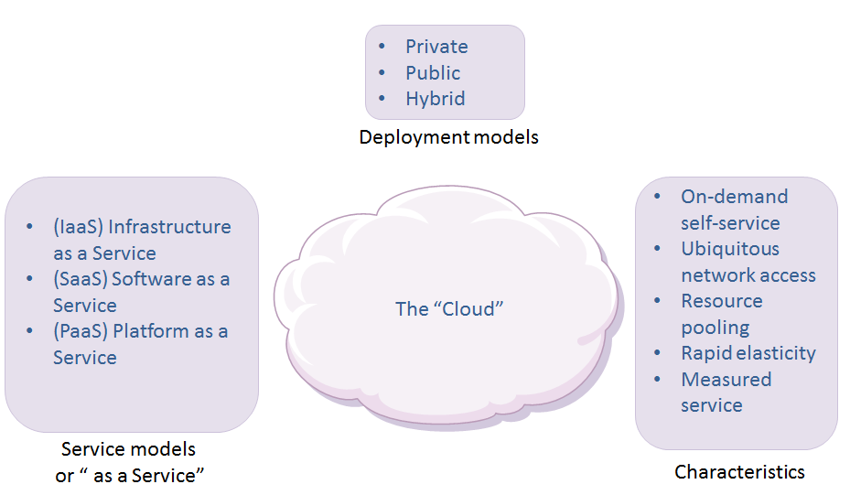
Cloud – the basics
"Cloud computing is a model for enabling convenient, on-demand network access to a shared pool of configurable computing resources (e.g., networks, servers, storage, applications, and services) that can be rapidly provisioned and released with minimal management effort or service provider interaction."
Notes:
There are a number of definitions for "The Cloud" and all are derived from the definition by the National Institute of Standards and Technology
"Cloud computing is a model for enabling convenient, on-demand network access to a shared pool of configurable computing resources (e.g., networks, servers, storage, applications, and services) that can be rapidly provisioned and released with minimal management effort or service provider interaction."
A cloud generally demonstrates the following five characteristics, three service models and three deployment models.

Slide 6
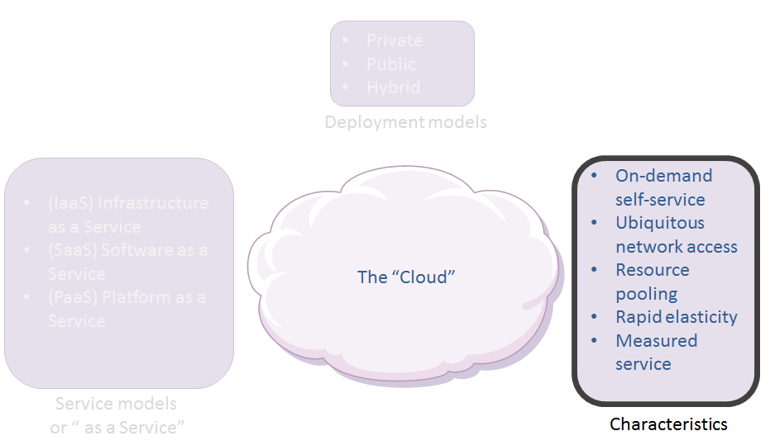
Cloud characteristics
On-demand self-service: provisioning or de-provisioning of computing resources as needed in an automated fashion
Ubiquitous network access: computing resources can be accessed from anywhere over a network
Resource pooling: Resources can be dynamically assigned, reassigned or de-allocated as per the requirement
Rapid elasticity: illusion of infinite computing resources
Measures service: consumers only pay for the computing resources consumed
Notes:
On-demand self-service is the provisioning or de-provisioning of computing resources as needed in an automated fashion without human intervention. Consider how electricity is provided as a utility. The consumer can turn on or off a switch to use as much electricity as required.
Ubiquitous network access means that computing resources can be accessed from anywhere over a network using various clients (for example: smartphones, tablets, laptops, personal computers and so on).
Resource pooling means that computing resources are pooled to meet consumer demands. Resources (physical or virtual) can be dynamically assigned, reassigned or de-allocated as per the requirement. Consumers are generally not aware of the exact location of computing resources. However, they may be able to specify location (country, city, region and the like) for their need. For example, a Canadian based bank (consumer) might want to host services with a cloud provider with cloud data centers within the boundaries of Canada.
Rapid elasticity is the illusion provided by cloud computing to users of infinite computing resources. In cloud models, resources can be elastically provisioned or released according to demand. For example, an enterprise's cloud-based online services should be able to handle a sudden peak in traffic demand by expanding the resources. When the peak in traffic subsides, unnecessary resources can be released automatically.
Measured service means that consumers only pay for the computing resources they have used. This concept is similar to water and electric utilities.

Slide 7
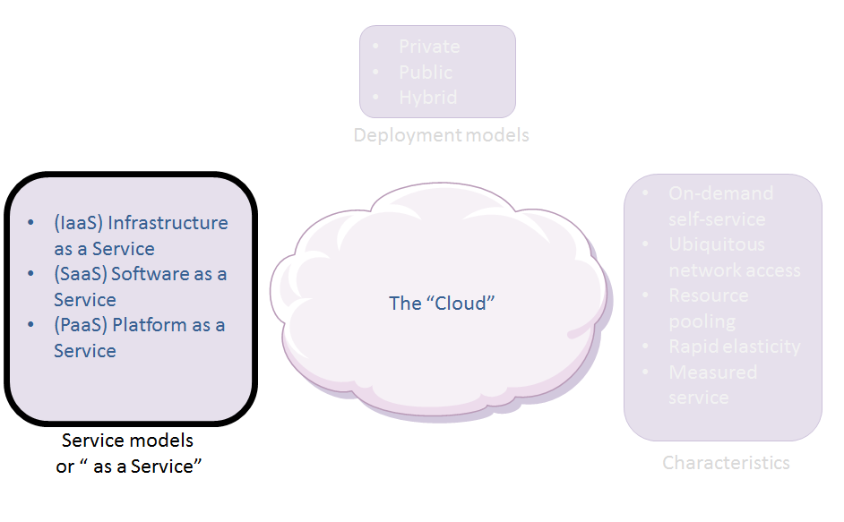
Cloud service models
Iaas: The delivery of computing infrastructure (networking, storage, compute) as a service
SaaS: The hosting of applications by a provider on a cloud infrastructure accessed from thin or thick clients over the network or a program interface
PaaS: The delivery of the infrastructure as well as middleware (databases, messaging engines and so on) and solution stacks for application build, development and deploy.
Notes:
XaaS is a collective term that stands for "anything as a service" or "everything as a service." The acronym refers to an increasing number of services that are delivered over the Internet rather than provided locally or on-site.
The most common examples of XaaS are Software as a Service (SaaS), Infrastructure as a Service (IaaS) and Platform as a Service (PaaS). The combined use of these three is sometimes referred to as the SPI model (SaaS, PaaS, IaaS). Other examples of XaaS include storage as a service (SaaS), communications as a service (CaaS), network as a service (NaaS) and monitoring as a service (MaaS).
This course provides discussion on the three most common cloud computing service models.

Slide 8
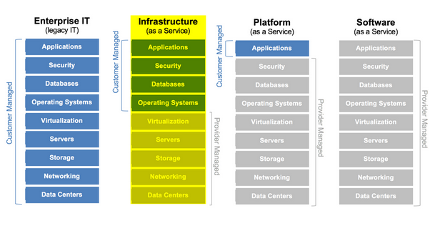
Cloud service models: IaaS
Integrates basic services into one platform for deploying and running applications:
Virtual servers
Data storage
Networking
Basic services are managed by the cloud provider.
Applications, security, databases and operating systems are managed by the customer.
Two primary characteristics:
Elasticity
Machine virtualization.
Notes:
IaaS integrates basic services such as virtual servers, data storage, and networking into one platform for deploying and running your applications. These basic services are managed by the cloud provider. Applications, security, databases and operating systems are managed by the customer.
There are two primary characteristics of IaaS. Elasticity is the primary characteristic of IaaS. The second characteristic is machine virtualization.
For an elasticity example, imagine you are a genetic researcher working for a major research facility. The facility is short staffed and you have been tasked with compiling all the genetic data for a new research study. You are responsible for formulating the necessary statistical data so that the advisory council can make important decisions regarding funding allocations in a week. This job is highly visible and you have a deadline quickly approaching. The volume of data you must process is enormous. After talking to the IT staff, you find out the compute resources required to compile the date will take the IT department three weeks to get ready.
This is the kind of problem that you can be mitigate by using IaaS. As a matter of fact, using IaaS, you could have the entire genetic data analysis completed in a day. You start by creating a single instance of a server (image) that contains the database software to run queries on the data. After deploying the image and importing the data into the database, you duplicate that image as many times as necessary and start running data-processing jobs. While the jobs are running, resources are manually or automatically removed according to the workload.
IaaS is normally platform-independent and it consists of a combination of hardware and software resources. IaaS software is low-level code that runs independent of an operating system. This code is called a hypervisor and is responsible for taking inventory of hardware resources and allocating resources based on demand. This process is referred to as resource pooling and makes machine virtualization possible. Virtualization makes multi-tenant computing possible. Multi-tenant computing is the concept that an infrastructure is shared by several organizations with similar interests regarding security requirements and compliance considerations.

Slide 9
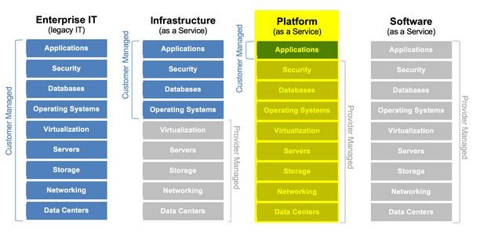
Cloud service models: PaaS
Enables developers to build and deploy web applications on a hosted infrastructure
Resources include everything managed by the provider that is necessary to support the application.
Two main components:
Computing platform such as Windows or Linus
Solution stack that consists of the apps used for development and deployment
Notes:
PaaS enables developers to build and deploy web applications on a hosted infrastructure and allows them to leverage the seemingly infinite compute resources of a cloud infrastructure. As shown in the graphic, those resources include everything managed by the provider that is necessary to support the application.
PaaS has two main components: computing platform and solution stack.
The computing platform is where software is launched as long as the code meets the standards of that platform. Common examples of computing platforms for operating systems include Windows, Apple Mac OS X, and Linux. It is important to remember is that is not the software itself but rather the platform on which it is built to run.
The service provided by the PaaS is referred to as a solution stack. A solution stack consists of the applications built for the development process as well as the deployment of the application. These applications refer to the operating system, run time environments, source control repository, and any other required middleware.

Slide 10
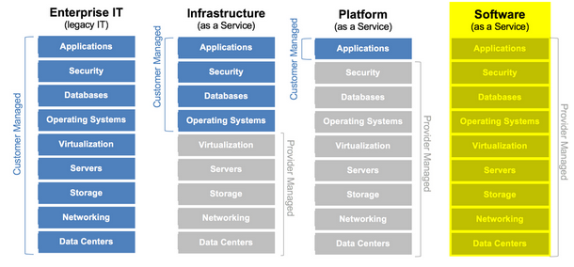
Cloud service models: SaaS
Provides network-based access to commercially available software.
Enables:
Speedy software deployment
Faster user adoption of software
Fewer support requirements
Ease in implementation and upgrades
Common examples include Gmail and Google Docs.
Notes:
SaaS provides network-based access to commercially available software. SaaS can lead to speedy software deployment, faster user adoption of software, fewer support requirements, and ease in implementation and upgrades. Common examples include Gmail and Google Docs.
Four main factors move enterprises to take advantage of SaaS and increase their ROI.
Quicker deployments than compared to updating hundreds or thousands of devices with a specific software version. Software is hosted on many different computer resources, all contributing to the total compute power able to run the many software instances required to service clients around the world.
Increased user adoption for the general consumer by making software available that previously may have carried too high a licensing fee to be reasonable for general consumer use.
Reduced support requirements is the result of having to support fewer platforms.
Lowered cost of implementation and upgrades are gained as a result of gaining control over versioning and the infrastructure needed to run the software. Savings come from no overhead to test and deploy bug fixes and new features on multiple platforms.

Slide 11
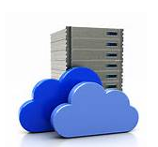
Cloud service models: DBaaS
Software that enables users to provision, manage, consume, configure, and operate database software without having to know about the implementations of specific database software.
Example:
Provision a MySQL database, manage, configure and operate it using the same set of API calls as if it were an Oracle or MongoDB database.
Request a backup of the database using an API call or request a MySQL cluster or a MongoDB cluster,
Resize that cluster without knowing how those operations were performed for each database technology.
Benefits to the enterprise:
Developer agility
DBA productivity
Application reliability, performance, and security
Notes:
DBaaS is an extremely fast growing segment of the cloud service provider industry. It is often considered part of the PaaS component, providing significant productivity improvements, performance, standardization, and data security.
The term DBaaS refers to software that enables users to provision, manage, consume, configure, and operate database software without having to know about the implementations of specific database software. In other words, a DBaaS user can provision a MySQL database, manage, configure and operate it using the same set of API calls as if it were an Oracle or MongoDB database. The user can request a backup of the database using an API call or request a MySQL cluster or a MongoDB cluster, and then resize that cluster without knowing how those operations were performed for each database technology.
There are a number of benefits a DBaaS solution provides the enterprise:
Developer agility. DBaaS standardizes the provisioning model and ensures that a database can be provisioned in a single operation, in a consistent way, and aligned with the best practices for that particular database and business. Complex database operations like resizing a cluster are simplified with an API call. The developer does not need to be concerned with how this operation should be performed for the specific database and version. The abstraction provided by the DBaaS allows the developer to focus on application development rather than the underlying database.
DBA productivity. DBAs can manage groups of databases and perform upgrade and configuration operations on a family of databases in a simplified way. DBAs are freed up to focus on activities like establishing the standards of operation for the enterprise and verifying the best tools are available for themselves and developers.
Application reliability, performance and security. Often databases are considered the “system of record” for the organization. Database outages can have a catastrophic impact on the business. Automation and standardization provided by the DBaaS ensures consistent and common workflows involved in database provisioning, configuration, management, and operation. Standardization ensures that all databases are operated consistently, keeping best practices established by the IT organization. Standardization through the DBaaS frees up the developer and DBA to focus on the application and innovation rather than the daily administration of running a database.

Slide 12
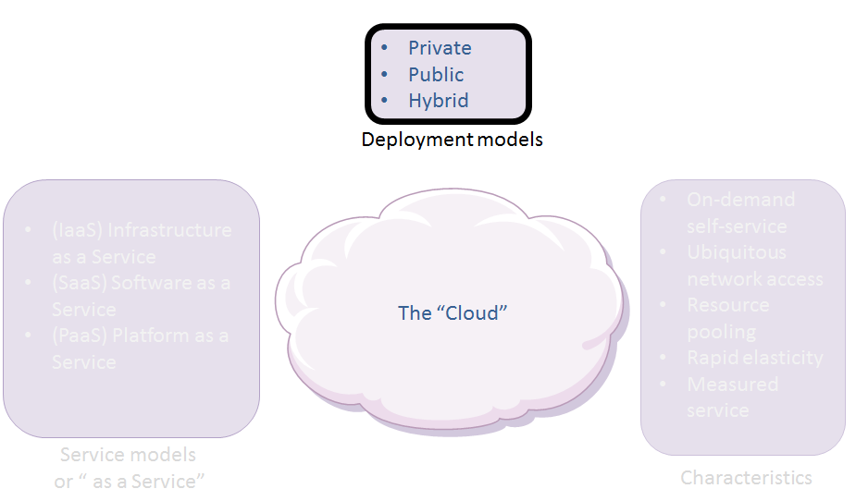
Cloud deployment models
Private: Resources are owned by an organization and maintained either by the organization or a third party. The resources can be located on-site or off-site. Computing resources are behind the corporate firewall.
Public: Resources are provided by a "cloud provider". These resources are used by different organization through public Internet on a pay as you go model. Separation of resources is ensured by the cloud provider. This concept is known as multitenancy.
Hybrid: Combination of the public and private deployment models connected by a standardized or proprietary technologies.
Notes:
In a private cloud, computing resources are solely owned by an organization and maintained either by the organization or a third party. The resources can be located on-site or off-site. Computing resources are behind the corporate firewall.
Public cloud computing resources are provided by a "cloud provider". These resources are used by different organization through public Internet on a pay as you go model. Separation of resources is ensured by the cloud provider. This concept is known as multitenancy.
The hybrid cloud is a combination of the public and private deployment models connected by a standardized or proprietary technologies.

Slide 13
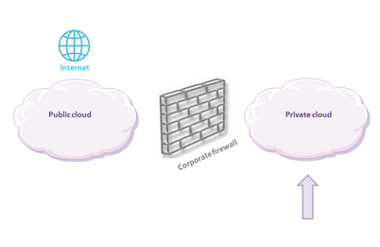
Cloud deployment models: Private
Software-defined data center
Combines essential hardware and other computing resources into a unified virtualized unit
Enables enterprises to scale and provision resources more dynamically than with traditional hardware-centric computing environments
Typically hosted within a company's firewall
Notes:
A private cloud is a software-defined data center that combines essential hardware and other computing resources into a unified virtualized unit. A private cloud’s layer of hardware and networking abstraction, which is provided by software, enables enterprises to scale and provision resources more dynamically than is possible with traditional hardware-centric computing environments.
In contrast to public cloud computing, a private cloud is typically hosted within a company’s firewalls. Some companies host their private cloud with an external third party provider, which allows these deployments to tap into external compute resources on an on-demand basis.
Ideally, a private cloud allows businesses significant cost savings over legacy hardware-based deployments. In contrast to a public cloud, it enables far greater flexibility, security and privacy.
Challenges
Private cloud faces a number of challenges. As with traditional deployments, companies must pay for the majority of architecting and monitoring work themselves. Private cloud is still evolving, so the deployment built this year may need a revision of some type next year. When planning and building a private cloud, either in-house or with vendor involvement, the enterprise must consider the reason for constructing a private cloud and what it should do.
Before building a private cloud, an enterprise must decide whether to run in its data center or host it in a third party location. These are some points to consider.
External private cloud: An externally hosted private cloud is often referred to as a managed private cloud. The private cloud offers greater security, privacy and control than a public cloud. But locating a private cloud in an external facility seems to contradict this. What are the ramifications if the private cloud host changes its end users agreements in some way, how can the enterprise to shift to a new provider?
Hosted private cloud: A hosted private cloud is different than a public cloud from a big public cloud vendor such as Amazon. In a managed private cloud scenario, the enterprise extends a separate security perimeter around this third party cloud.
Reasons for external: Why host your private cloud externally? Some analysts say that a business must have at least 1,000 servers to justify building its own private cloud. Many businesses do not have that many, thus hosting a private cloud with a third party provider, or leveraging a managed private cloud from an external vendor may be more practical.
Security concerns: Another concern is the possibility of a security breach. It is in the best interest of cloud service providers to keep up with evolving security trends, but what happens when something goes wrong? How will the service provider accept accountability?

Slide 14
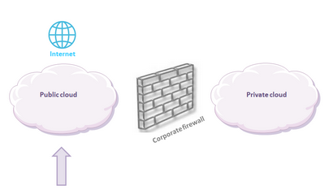
Cloud deployment models: Public
Scalable and elastic IT-enabled capabilities are provided as a service
Supports customers that are external to the provider’s organization
Notes:
Public cloud computing is one of the fastest-growing markets within enterprise IT. It allows anyone to gain immediate access to computing resources via the Internet and pay for those resources based on how much they consume. Public cloud has reshaped the enterprise IT industry, prompting vast changes in how datacenters are managed.
Public cloud computing is a style of computing where scalable and elastic IT-enabled capabilities are provided as a service to external customers using Internet technologies. Public cloud computing uses cloud computing technologies to support customers that are external to the provider’s organization.
In simple terms, public cloud services are computing resources accessed via the Internet that customers can buy from a third-party provider. That is different from a private cloud, which are services that organizations or individuals set up for their own use, and a hybrid cloud, which is a combination of public and private clouds that are managed together.
Features and Benefits
In the early days of public cloud computing, the top reason for using the cloud was reduction in costs, however, in recent years that has changed. The following list outlines the top reasons for using a public cloud:
Agility: The public cloud gives organizations the ability to provision and deploy new computing resources instantaneously. That is a tremendous benefit compared to private clouds or traditional data centers where it can take up to several months for staff to acquire servers and the other infrastructure necessary for a project.
Availability: Cloud outages are always a possibility, but public cloud computing services are generally much more reliable than in-house data centers. Service level agreements (SLAs) are offered that include uptime guarantees. Failover and disaster recovery can be easier to set up and manage with public cloud services. Many enterprises choose to use the public cloud as a key part of their disaster recovery or business continuity plans.
Financial Benefits: The financial benefits of the public cloud are significant on several points. (1) The public cloud allows organizations to pay only for what they use, thus eliminating the need for costly over-provisioning. (2) The public cloud allows organizations to eliminate some of the upfront costs of infrastructure and convert them to operating expenses through subscriptions. (3) Public cloud providers can achieve economies of scale that drive down prices by managing their own infrastructure. (4) Using the public cloud may also allow organizations to reduce IT management costs.
Location Independence: Because users access public cloud services via the Internet, they can access them from nearly anywhere. Most public cloud providers are expanding their network of data centers thus offering cloud-based services to a global audience.
Performance: With public cloud services, users can select the level of performance they need for various workloads. For example, data archiving may require a slower public cloud storage service and a service with faster response times for data that needs to be accessed regularly. In a similar manner, complex workloads that need quick processing can be spun up on high-performance computing instances or lower-cost, lower-performance instances for workloads that may not require the same performance level.
Scalability: The public cloud also allows organizations to scale up usage as necessary. This is very beneficial for organizations that experience demand surges, such as retailers that see dramatic increases in online transactions near the holidays. It is also useful for companies or projects that are experiencing rapid growth.
Tool Sets: Public cloud providers usually offer a menu of additional capabilities. These often include artificial intelligence and machine learning to platforms for app development to Big Data applications to security features. This trend toward a growing cloud-based feature set enables the cloud to offer a competitive advantage.

Slide 15
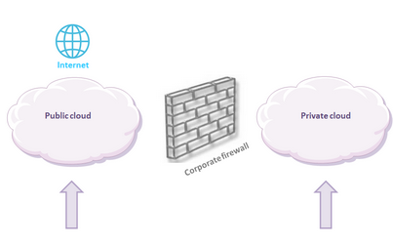
Cloud deployment models: Hybrid
Enterprise architecture that integrates public and private clouds
Maintain some data and applications in their own data centers, often for compliance or security reasons
Integrate with the public cloud services
Notes:
Many enterprises integrate their public and private clouds into hybrid clouds allowing them to keep some data and applications in their own data centers. This is often done for compliance or security reasons, while integrating with the public cloud services they use.
The hybrid cloud is the most widely-used choice for cloud services among enterprise IT firms for a variety of key reasons, all of which center around flexibility and scalability. As discussed in a previous section, a private cloud is always part of a larger infrastructure. However, there are very few private clouds that fit all their compute resources into a single integrated private cloud.
However, building a hybrid cloud can be challenging as organizations need tools and employees with the ability to manage multiple private and public cloud platforms.
Consequently, most private clouds are part of a hybrid cloud deployment, which includes both a private cloud and public cloud; or some form of in-house and externally hosted cloud. The variations are numerous. For instance, many companies use sales automation software which in SaaS fashion, no longer resides in the datacenter. Instead vendors charge a per user license fee and maintain the applications.
Where do the customers store the resulting sales data? Quite likely in a hybrid cloud with data about potential customers in a lower-cost public cloud and sensitive paying customer data is stored securely into an in-house private cloud.
The notion of “more sensitive” vs. “less sensitive” types of data steers the discussion about the hybrid cloud. For example, a company may outsource its email service to a public cloud service, yet store its strategic R&D data in a private cloud. A company may outsource part of its HR work and store it in a pubic cloud, yet for regulatory reasons the company stores sensitive personnel data on a private cloud.

Slide 16
Cloud computing provisioning
Notes:
In this segment of the presentation,

Slide 17
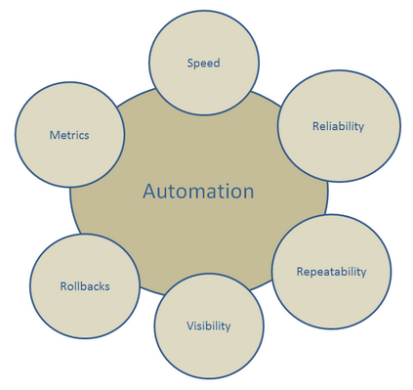
Automation
Automation can address the needs of several architectural layers:
At the server layer, the trend toward using highly automated configuration tools like Puppet work with large and dense server farms. Cloud automation tools allow you to effectively manage and provision installed capacity.
At the software layer, complex systems can be configured once and then rolled out in an agile manner. Intelligent systems architecture can balance the load among compute, network or storage resources, bringing systems online or offline as demand dictates.
Infrastructure automation involves template creation for infrastructure that can be replicated and deployed.
Notes:
At the beginning of the cloud computing adoption cycle, companies typically look for cost reductions and efficiencies. They begin the cycle with virtualization, which is why these technologies account for a large percentage of the cloud-enabling technology market. Virtualization alone does not allow a company to scale its cloud infrastructure and realize the full benefits of cloud’s flexibility. Cloud automation and configuration management tools enable scaling, and give a company the visibility and control needed to control use and cost of cloud services.
Recall the five characteristics of the cloud. One of the five characteristics of a cloud is that the cloud should be self servicing. Self service implies automation at some level with automation describing a task or function accomplished without human intervention.
Layers of cloud automation
The architecture of a private data center can be considered in layers and automation can address the needs of each layer. In large and increasingly dense server farms, there are just too many machines to care for each one manually. At the server layer, the trend toward using highly automated configuration tools like Puppet work nicely at this layer. With cloud automation tools you can effectively manage and quickly provision the capacity you have installed.
Automation extends to the software layer, where complex systems can be configured once and then rolled out in an agile manner, using cloud automation tools. Intelligent systems architecture can balance the load among compute, network or storage resources, bringing systems online or offline as demand dictates.
Infrastructure automation is one of the most basic types of cloud automation, involving template creation for infrastructure that can be replicated and deployed. With infrastructure automation, processes are automatically deployed throughout the system, and manual effort is reduced.
Lastly, self-healing automation involves finding errors within the system, correcting them automatically, and notifying those responsible with management responsibility.
Cloud automation framework benefits:
Fewer errors. An automated system is going to repeatedly perform the same task at the same time in the same way. Through automation, the possibility for human error is significantly reduced.
Lower cost. Cloud automation frameworks have lower costs as less administrative and IT time is spent on automated tasks. Instead, the resources that would have gone to these automated tasks can go to improvement of operations and revenue generating activities.
Better scalability. Automating tasks creates an organization that can scale up without having to worry about allocating an increasing amount of money and time

Slide 18
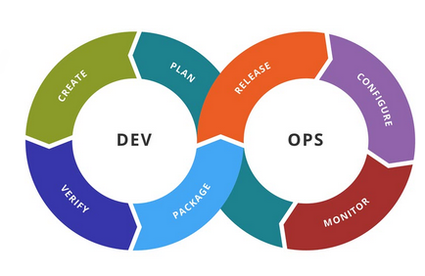
DevOps
... the practice of operations and development engineers participating together in the entire service lifecycle, from design through the development process to production support.
DevOps does not differentiate between different developer and sysadmin sub-disciplines. Generally...
Dev is shorthand for developers, however in practice it means all the people involved in developing the product. Dev can include Product, Test, QA, and other disciplines.
Ops is a term for systems engineers, system administrators, operations staff, release engineers, DBAs, network engineers, security professionals, and various other subdisciplines and job titles.
Notes:
There are many reasons to adopt a DevOps approach.
Speed
The movement towards towards DevOps, is driven by agility and speed. Companies and organizations want to deliver functionality faster. Consider mobile phones. The market demands that apps are updated on a daily basis, with new functionality showing up, and a lot of competitive pressure to continue to innovate. Data suggests that if an enterprise can improve website performance by a second, it can increase sales from 3 to 8 percent.
IT departments with a strong DevOps workflow often deploy software more frequently than low-performing IT departments. Recovery times are faster and they experience lower rates of change failure. Businesses spend less time overall addressing security issues and less time on unplanned work.
To support this demand for speed, enterprises need infrastructure that is easily available and can be provisioned on demand. Applications and code must be updated on a weekly or daily basis rather than once a year. There are so many digital transformation strategies that enterprises need to be positioned to react quickly. DevOps is critical for digital transformation, allowing the enterprise to be more agile, deliver software faster and react to market conditions in a timely manner.
Security
In speeding up development and combining the expertise of developers and system administrators, spotting and fixing vulnerabilities quickly becomes possible. This also makes creating and deploying security updates and patches faster, which in turn reduces the risk of commonplace security threats such as intrusions, data leakage, and ransomware.
Cohesion
DevOps can help bridge the gap between programmers, operations, and all professionals in a company. By creating a cross-functional team where employees feel they have a real stake in improving the company's speed and functionality, DevOps can be transformative to the company.
While DevOps is a business IT philosophy and approach, making it work requires three broad sets of tools. These tools are:
continuous integration/continuous development (CI/CD) tools
management software
container orchestration programs.
CI/CD tools
Continuous integration/continuous development tools enable developers to regularly merge their code changes into a central repository. Each code check-in is verified by an automated build. This process allows teams to find bugs much earlier in the development process.
The key goals of continuous integration are to find and address bugs quicker, improve software quality, and reduce the time it takes to validate and release new software updates. Continuous integration makes it easier to locate and remove software bugs. Continuous development moves this on to the idea that all merged code is production-ready.
Each CI/CD tool has its own focus. Jenkins is an open-source tool that works with a number of operating systems and platforms. It is the open-source standard for managing the dev side of DevOps, from source code management to delivering code to production.
Management
DevOps management tools have a goal to manage enterprise-scale server infrastructure with minimal sysadmin and developer input. These tools assist with automating configuration management. This saves time and enables you to run hundreds, even thousands of servers per sysadmin.
These tools enable the creation of master copies of the software stacks and servers needed for your work. You can implement thousands of identical instances. If you need to change your database server, each allows you to switch out DBMSs in multiple servers. The end result is an enormous savings in time of server and software deployment.
There are a number of tools in this product segment and each works somewhat differently.
Ansible simplifies complex orchestration and configuration management tasks. Ansible works well with its Linux and cloud programs. It enables administrators to script commands in YAML .
Chef turns infrastructure into code. It is a framework to automate and manage infrastructure and applications. This method enables management of both cloud and on-premises resources. Specifically, Chef translates system administration tasks into reusable definitions, known as cookbooks and recipes. These are written in a domain-specific language (DSL) dialect of Ruby. Because the recipe DSL is a Ruby DSL, anything that can be done using Ruby can also be done in a recipe.
Puppet does similar work as the other tools by providing configuration management services through a client/server approach. Puppet's instructions are written in the DSL: Puppet. Like Chef, these are based on Ruby.
Container orchestration
Containers are becoming the dominant cloud-enabling technology, primarily because containers use fewer system resources than VMs. However, managing containers still requires resources and expertise. Short lifetimes and increased density have significant implications for infrastructure monitoring. They represent an order-of-magnitude increase in the number of things that need to be individually monitored.
Docker is the leading container company. Kubernetes is the most popular container orchestration program. CoreOS offers a high degree of interoperability, as well as self-healing, automated rollouts and rollbacks, and storage orchestration.
Specifically, container orchestration tools provide four services:
Provisioning: These tools can schedule, provision and launch containers within a container cluster.
Configuration scripting: Scripting permits you to load specific application configurations into containers in the same way you might already be using Puppet Manifests or Chef recipes. These are written in YAML or JavaScript Object Notation (JSON).
Monitoring: These tools track and monitor containers' health and hosts in the cluster. When a container fails, the monitoring tool spins up a new instance. If a server fails, the tool restarts the containers on another host. The tools also run system health checks and report irregularities with the containers, their VMs and servers.
Rolling upgrades and rollback: When you deploy a new version of the container, or the applications running within the containers, the container management tools automatically update them across your container cluster. If something fails, you can roll back to the last known good configurations.

Slide 19
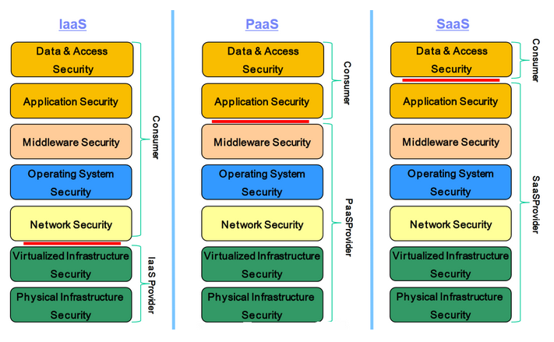
Security
The "security line of responsibility" is shown by a red line and indicates where an enterprise (consumer) can invest more money and resources.
The line varies depending on which cloud service model is utilized.
Example: an enterprise the utilizes the SaaS service model can spend its resources data security and access security, since the SaaS provider is responsible for securing the stack below the data level.
Notes:
With each of the cloud service models, the "security line of responsibility" is shown by a red line. The line in the graphic indicates where an enterprise (consumer) can invest more money and resources. The line varies depending on which cloud service model is utilized. For instance, an enterprise the utilizes the SaaS service model can spend its resources data security and access security, since the SaaS provider is responsible for securing the stack below the data level.

Slide 20
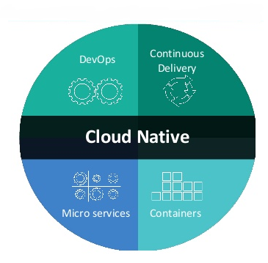
Cloud native
Cloud native is about the application architecture and design...less about how you code the application
An approach anchored in container technologies and DevOps practices for building and continuously delivering applications and microservices
Applications are designed so they are decoupled from any specific physical resource
Clouds provide an abstraction or virtualization layer between the application and the underlying physical (or virtual) resources, whether they are designed for cloud or not.
Notes:
Cloud native is about the application architecture and design, and not as much about coding the application. It is an approach anchored in container technologies and DevOps practices for building and continuously delivering cloud native applications and microservices.
Applications should be designed so they are decoupled from any specific physical resource. Clouds can provide an abstraction or virtualization layer between the application and the underlying physical (or virtual) resources, whether they are designed for cloud or not. Cloud native can take this philosophy even further.
When this architecture is considered in the design, development, and deployment of an application, the utilization of the underlying cloud resources can be as much as 70 percent more efficient than traditional architectures. This cloud computing efficiency equals monetary savings. Applications that work more efficiently with those resources run faster and generate smaller cloud services charges at the end of the month.
Clouds have different ways for you to leverage their native features. You can normally access these features via layers, including the topmost virtual platform/OS, underlying resources (storage and data), and then the cloud-native services, such as provisioning and tenant management.
To be truly cloud native, you must understand how to properly use the cloud platforms, as well as the subplatforms and resources.

Slide 21
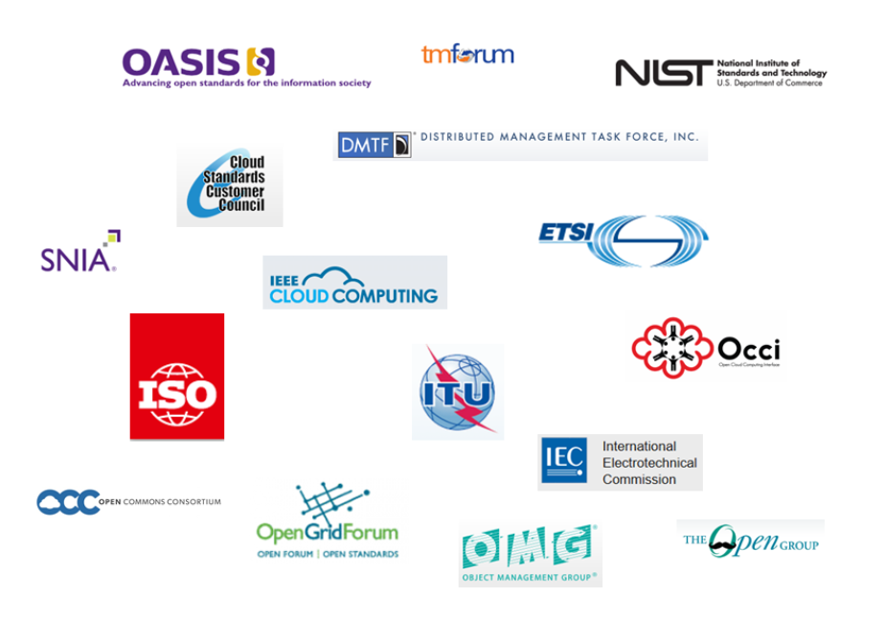
Standards
For cloud developers and designers, standards are a powerful addition to their toolbox that allows them to spend more time creating new apps engineered with elegant code, and less time working out compatibility issues.
Notes:
There are a number of organizations that manage and govern standards for cloud technologies. This list is representative, but not inclusive.
NIST is part of the U.S. Department of Commerce and it works to advance measurement science, standards, and technologies. NIST defines cloud computing for government and industry. It outlines the following aspects of cloud as discussed in this course.
Five essential characteristics:
On-demand self service
Broad network access
Resource pooling
Rapid elasticity
Measured service
Three service models
Cloud Software as a Service (SaaS)
Cloud Platform as a Service (PaaS)
Cloud Infrastructure as a Service (IaaS)
Four deployment models:
Private cloud
Community cloud
Public cloud
Hybrid cloud
Cloud Standards Customer Council (CSCC)
CSCC is an end-user advocacy group that seeks to "accelerate cloud's successful adoption" as a means to strengthen 21st century enterprises. It is a facilitator, working with existing standards groups to ensure that client requirements are addressed as standards evolve. This group understands that the transition from a traditional IT environment to a cloud-based environment can require significant changes, so it attempts to guarantee that this transition will not cost end-users the choice and flexibility they enjoy with their current IT environments.
Another role of the CSCC is to advocate for the establishment of open, transparent standards for cloud computing; the council believes that the agility and economic efficiencies cloud offers are only possible if the performance, security, and interoperability issues that arise during the transition to the cloud are answered in an open, transparent way.
Open Grid Forum (OGF)
OGF is an international group of IT professionals working through open forums and events to push for the rapid development and deployment of advanced applied distributed computing environments such as cloud, grid, and allied storage and network methods. The Forum focuses on scalable enterprise solutions as well as supporting applications for research and science. The OCCI specification, a "RESTful protocol and API for all kinds of management tasks," is available through OGF. OCCI includes various general-purpose implementations and tools focused on integration, portability, interoperability, and autonomic scaling and monitoring.
Open Management Group (OMG)
OMG is an international technology standards consortium that focuses on modeling programs, systems, and business processes and creating model-based standards. It provides only specifications, not implementations (but any group attempting to get a spec accepted by OMG must provide a working implementation within one year after acceptance). OMG is part of the CSCC.
OMG's Unified Modeling Language (UML) is the basis for modeling application structure, data structure, business process, and architecture. When used with UML's Meta Object Facility (MOF) and Model-Driven Architecture, the entire development process is unified which helps reduce cloud portability, interoperability, and reuse issues.
Distributed Management Task Force (DMTF)
DMTF is an association of industry IT companies and professionals collaborating on and promoting enterprise systems management and interoperability standards with a goal of providing "common management infrastructure components for instrumentation, control, and communication in a platform-independent and technology-neutral way."
This group supports several focus areas:
Open Virtualization Format (OVF)
The OVF standard, adopted as ISO 17203 by the International Organization for Standardization (ISO), creates uniform formatting for virtual systems-based software. OVF is platform independent, flexible, and open, and can be used by anyone who needs a standardized package for creating a virtual software solution that requires interoperability and portability.
Open Cloud Standards Incubator working group
The goal of this working group is to facilitate management interoperability between in-enterprise private clouds and public and hybrid clouds. The components — cloud resource management protocols, packaging formats, and security mechanisms—address the increasing need for open, consistent cloud management architecture standards.
Cloud Management Working Group (CMWG)
This working group uses the Cloud Infrastructure Management Interface (CIMI) to visually represent the total lifecycle of a cloud service. This visual representation can enhance the implementation and management of a service and make sure it is meeting service requirements. Using CIMI, the group can explain how to model the characteristics of an operation, allowing variation of an implementation to be tested prior to final development. CIMI creates data classes with well-defined associations and characteristics, as well as a conceptual framework for organizing these components. CIM uses discrete layers: core model, common model, and extension representations.
Cloud Auditing Data Federation Working Group (CADF)
This group works to standardize audit events across all cloud and service providers with the goal of resolving significant issues in cloud computing due to inconsistencies or incompatibilities. It seeks to ensure consumers of cloud computing systems that the security policies required on their applications are properly managed and enforced.

Slide 22
Resources
Cloud computing
http://www.redbooks.ibm.com/abstracts/redp5179.html?Open
https://www.ibm.com/developerworks/cloud/library/cl-cloudservicemodels/index.html
Security
https://www.ibm.com/developerworks/community/blogs/ibmsyssw/entry/top_3_fundamental_cloud_security_considerations?lang=en
Cloud standards
https://www.ibm.com/developerworks/cloud/library/cl-tools-to-ensure-cloud-application-interoperability/index.html
National Institute of Standards and Technology (NIST)
Open Cloud Consortium (OCC)
Cloud Standards Customer Council (CSCC)
Cloud native
https://developer.ibm.com/cloud-native/
Cloud automation
https://developer.ibm.com/cloudautomation/2017/11/14/intro-cam/
https://developer.ibm.com/tv/manage-cloud-automation/
Notes:
This is a short list of sources used when building this presentation.

